Slide 1
Introduction to Software Engineering

Slide 2

SDLC, PDLC, PMLC & SMLC

Slide 3
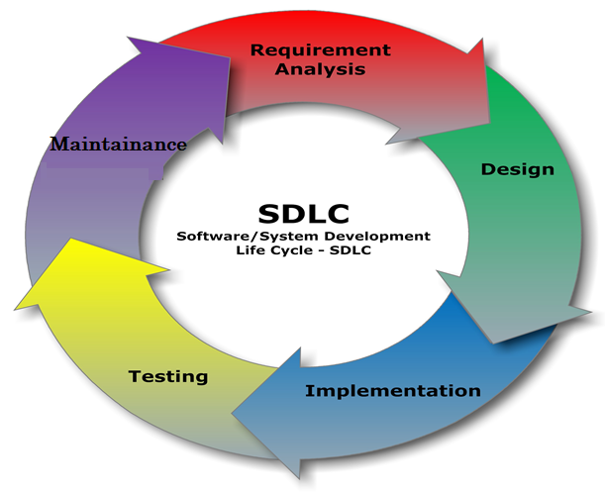
SDLC (Software Development Lifecyle)
- Feasibility Study - Requirements
- Architecture - Design

Slide 4
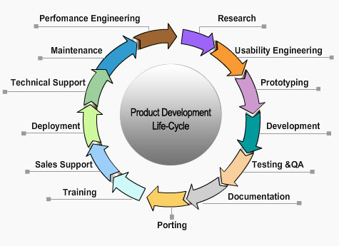
PDLC (Product Development Lifecyle)
Using a different lifecycle
Requirements Engineering
Architecture
Design
(Iterate and refine prototype)
Implementation

Slide 5
Project Management in System Dev Lifecycle
Initiation, Planning and Organization
Feasibility Analysis
Project Plan: Product, Schedule, Budget, Tasks
Requirements Engineering
Architecture & Design
Project Execution, Direction and Control
Implementation
Testing
Closure, Project review and process improvement
Operation & Maintenance

Slide 6
Software Maintenance Lifecycle
Problem/Modification /Enhancement
Delivered S/W component
Problem/Task Identification
Delivery (Patches, Releases)
Identified problem
Analysis
System, Regression, Acceptance Testing
Impact, Criticality, Priority
Approval for change
Review/Unit Test Change
Design the Change
Implement the change

Slide 7
Product Lifecycle
Attributes to Consider
Market capitalization
Sales
Investment
Competition
Profit
Support
Product built using a SDLC is initially released into market
Introduction
Growth
Maturity
Discontinuance
Obsolescence

Slide 8
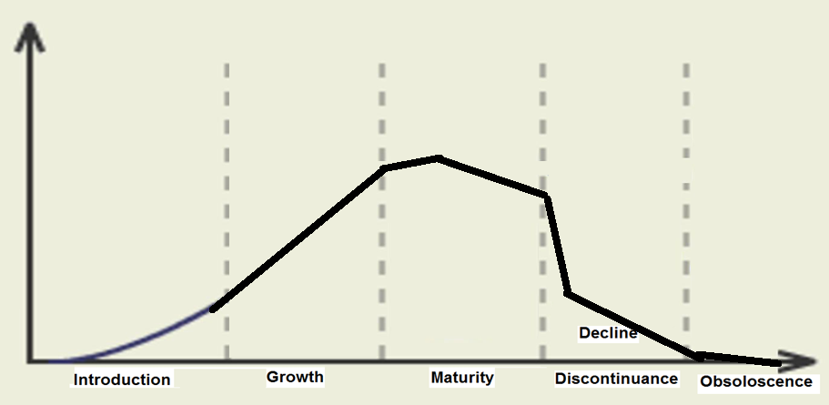

Product Life Cycle Characteristics
INVESTMENT
SALES / REVENUES
TIME

